Slide 1

MySoftwareBookList

Slide 2

Project Overview
Create a website that helps users gain insight from others about software books
The core idea is that books are organized by user scores
User’s can store books in a “list” that reflects their reading history and opinions

Slide 3
Project Goals and Scope
View software books
Order of the books changes based on user interaction
Save books in a list
See ratings and comments for books
Filter and Search books

Slide 4
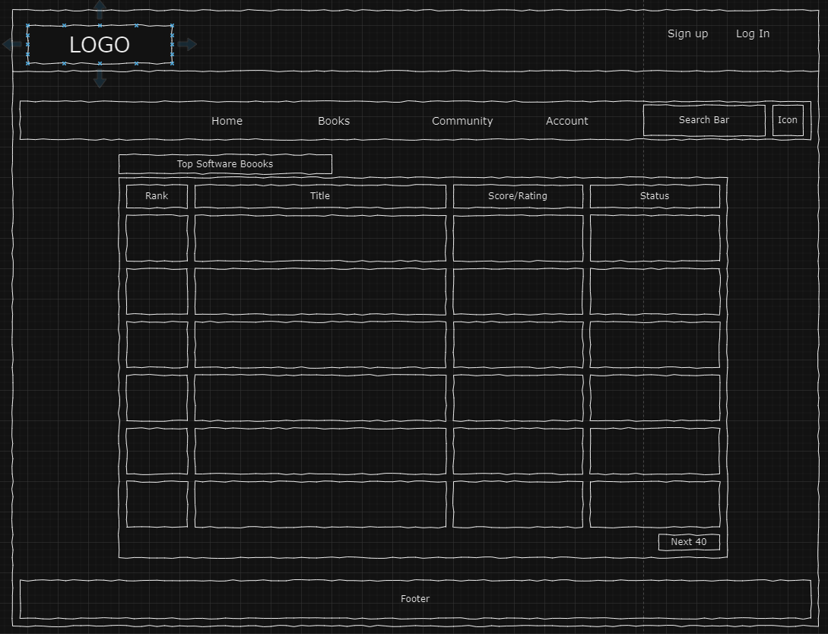
Books Wireframe

Slide 5
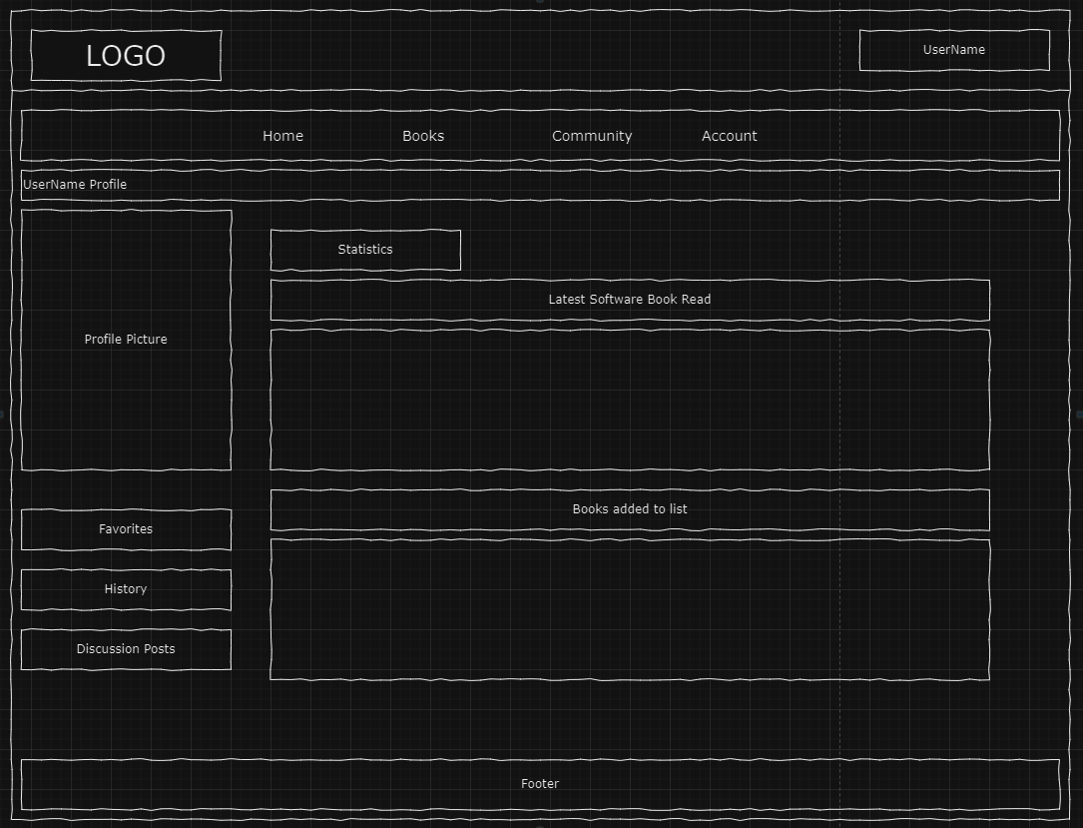
Account Wireframe

Slide 6
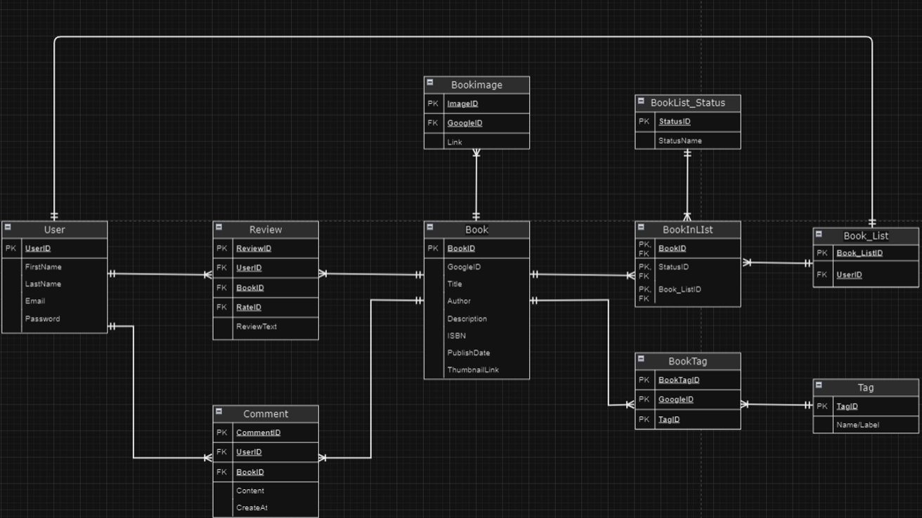

Slide 7
Google Books API
Used to populate our database with book data
Our first time using an API in a project
Also used for viewing details of an individual book

Slide 8
Demo

